Slide 1
Android
Apps for the model car

Slide 2
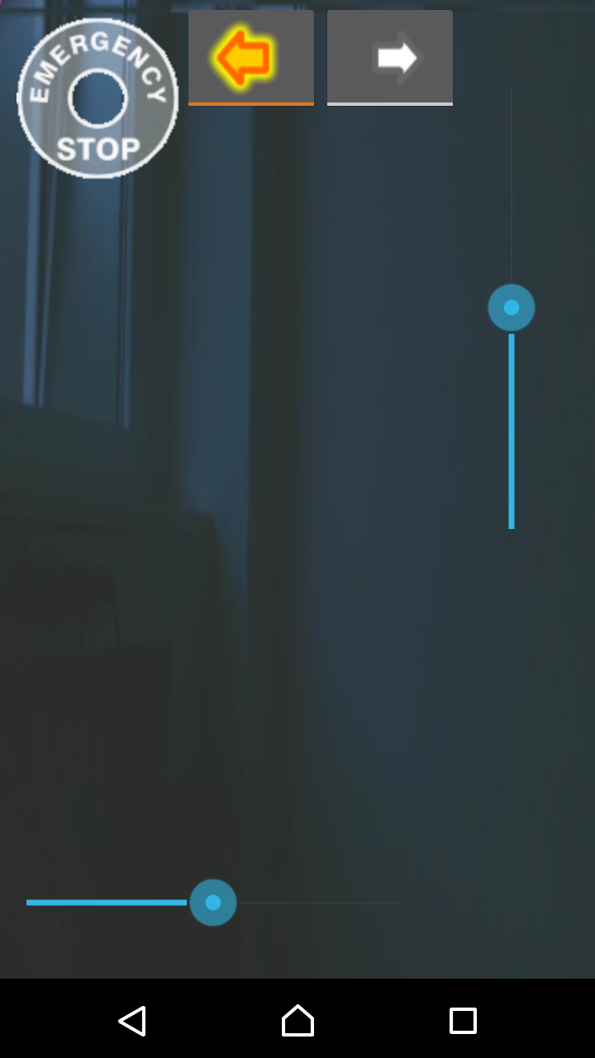
Car Control
control steering & velocity by a slider
emergency stop (disabled when gray)
left & right blinker
shows live images of model car’s front camera

Slide 3
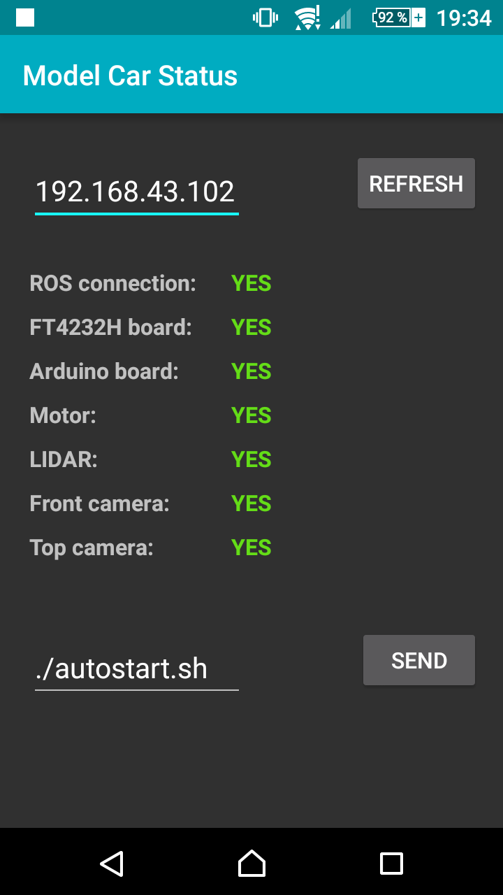
Car Status
checks connection from odroid to devices periodically
can start a program / script remotely (default autostart.sh)

Slide 4
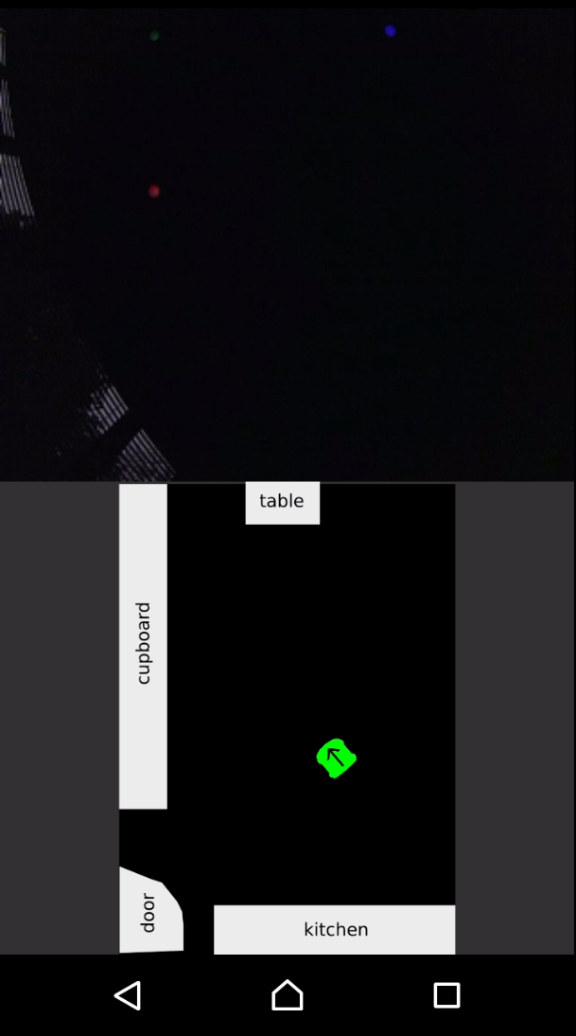
Car Localization
position of the model car on a map (provided by our visual_gps module)
live images of model car’s top camera

Slide 5
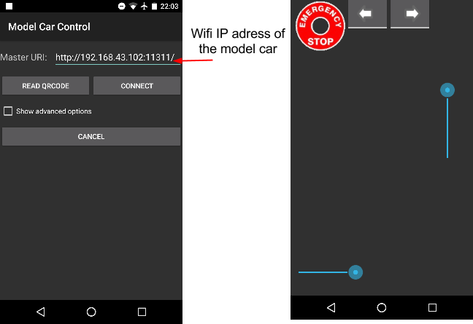
ROS Connection

